Slide 1
Trends in the Periodic Table

Slide 2
Welcome to this Smart Lesson about trends in the periodic table. After completing this lesson, you should be able to:
Describe two factors that contribute to an element's reactivity: number of valence electrons and atomic radius.
Distinguish metals and non-metals in terms of how their reactivity changes down a group.
Compare the reactivity of groups 1 and 2 elements, and groups 16 and 17 elements, in terms of their electron arrangements.

Slide 3
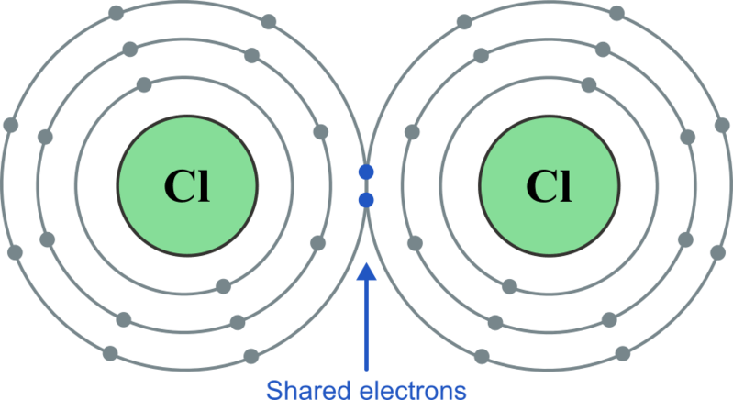
The outer electron shell (energy level) of an atom is called the valence shell.
Atoms with full valence electron shells are said to be stable, which means they do not readily react with other atoms.
Atoms without full valence shells usually react with other atoms by gaining, losing or sharing electrons in chemical bonds in order to achieve stability.

Slide 4

An atom's reactivity depends on two main factors:
1. | How many electrons it has in its valence shell.
2. | How far those electrons are from the nucleus.

Slide 5
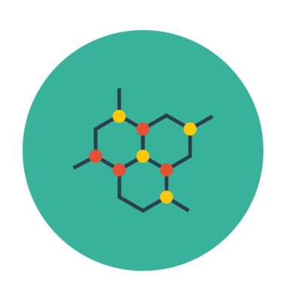
Factor 1: Number of electrons in the valence shell.
Atoms are most stable when their valence shell is full of electrons. During chemical reactions, atoms will gain, lose or share electrons with other atoms in order to achieve a stable state.
Atoms with the same number of valence electrons tend to react in the same way.
The elements in group 18 are called the noble gases or inert gases. They are unreactive because they already have full valence electron shells.

Slide 6

The easier it is for an atom to gain a full valence shell, the more reactive it will be.
For example, the elements in group 17 only need to gain one electron to achieve a full outer shell and become stable. This is easier (requires less energy) than gaining two electrons, which the elements in group 16 must do in order to achieve a full shell and become stable.
Therefore, the elements in group 17 are more reactive than the elements in group 16.

Slide 7
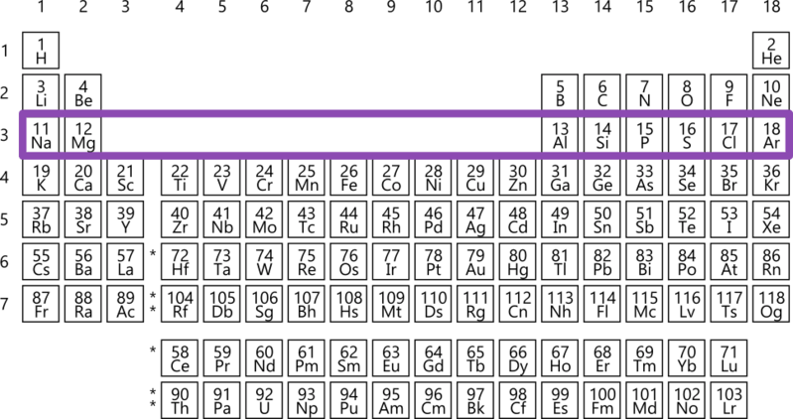
As you move across a period, the number of electrons in the valence shell increases.
Elements to the left of the periodic table are the metals. They have low numbers of electrons in their valence shells. In chemical reactions, they will lose electrons to empty their valence shells, as this requires much less energy than gaining many electrons.
Elements to the right of the periodic table are non-metals. They have high numbers of electrons in their valence shells. In chemical reactions they will gain electrons to fill their valence shells, as this requires much less energy than losing many electrons.

Slide 8
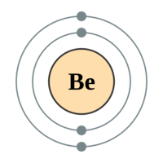
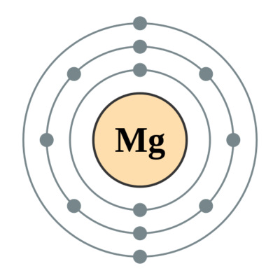
Factor 2: How far the electrons are from the nucleus.
Elements in the same period are approximately the same size, because they have the same number of electron shells.
Moving down a group, the number of electron shells in the atom increases. Adding more electron shells means that the size of atoms increases as you go down a group. The size of an atom can also be called its atomic radius.

Slide 9
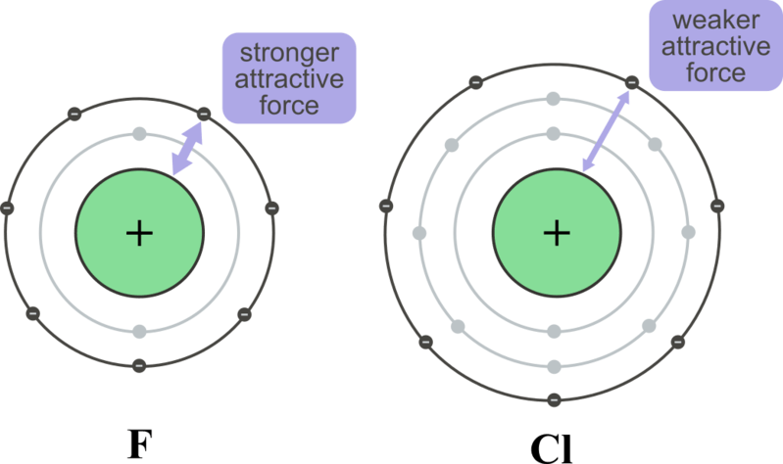
Negatively charged electrons are attracted to the positively charged protons in the nucleus. The further away from the nucleus the electrons get, the weaker this attractive force.
The effect of the atomic radius on reactivity depends on whether the element is a metal or non-metal.

Slide 10

Metals lose electrons in chemical reactions in order to become stable. The reactivity of metals increases down a group, because it’s easier to lose valence electrons as they get further from the nucleus.
Non-metals gain electrons in chemical reactions in order to become stable. The reactivity of non-metals decreases down a group, because it’s harder to gain electrons as the valence shell gets further from the nucleus.

Slide 11
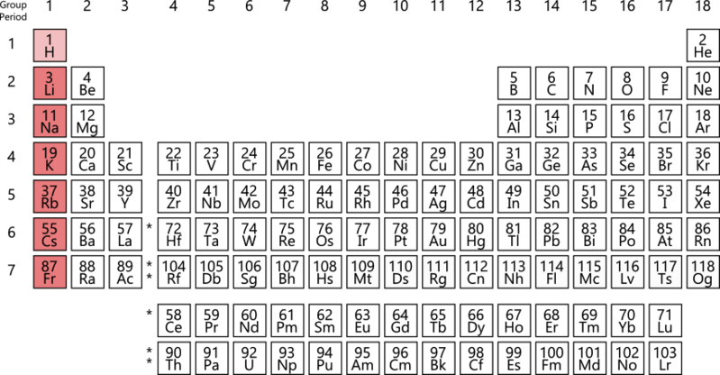
Elements in group 1 of the periodic table are also known as the alkali metals.
Although hydrogen is technically in group 1, it is not classed as an alkali metal as it has different properties to the other elements in this group (for example, it's a gas rather than a solid).

Slide 12
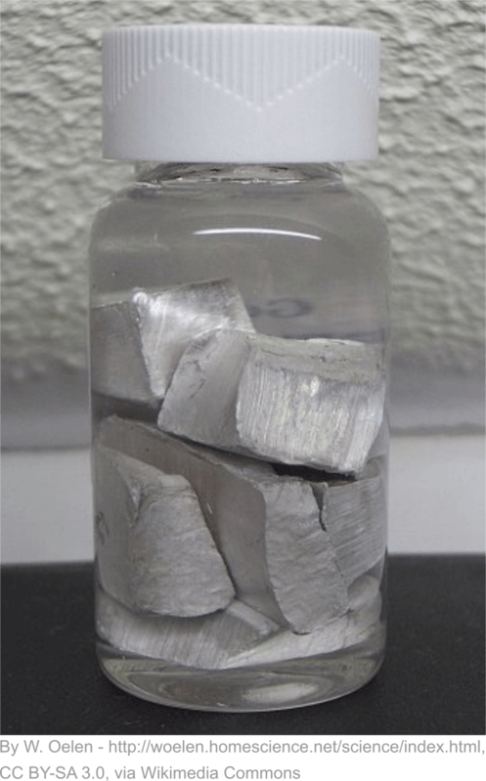
All elements in group 1 have only one valence electron.
It is very easy for them to give up this electron to another atom in order to gain a full valence shell.
This means the alkali metals are extremely reactive. They react so violently with water that they must be stored in oil to prevent them reacting with any moisture in the air.

Slide 13
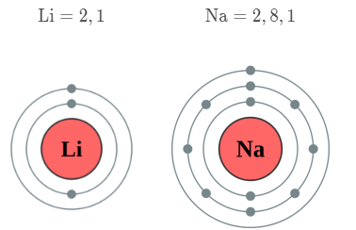
Lithium is the least reactive alkali metal, and the elements get more reactive as you move down the group.
Moving down the group, there are more electron shells and therefore the valence electrons get further away from the nucleus. This decreases the attractive force between the nucleus and valence electron, making it easier to remove the valence electron. The reactivity increases, which means the reactions will be faster and more violent as you move down the group.
The electron arrangements of the first three alkali metals are shown below.

Slide 14
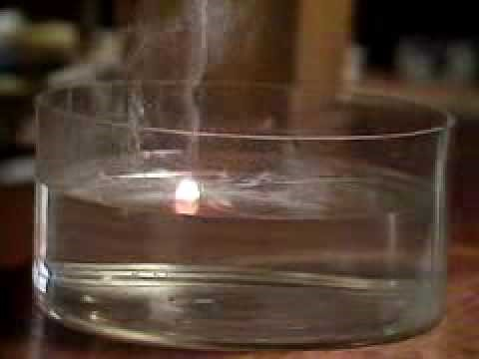

Slide 15
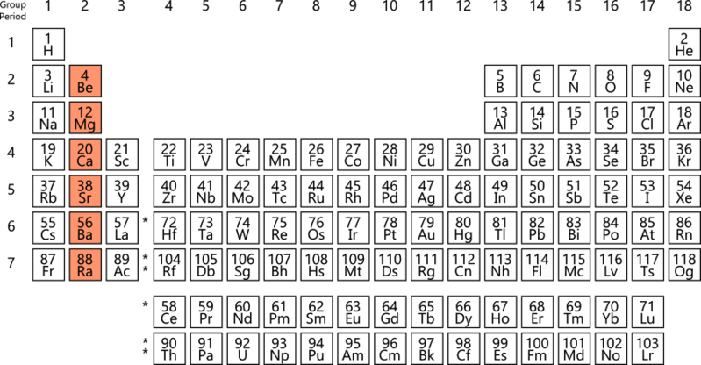
Elements in group 2 of the periodic table are called the alkaline earth metals.
They are less reactive than the group 1 metals, because they have two valence electrons. They must lose both of these electrons to achieve a full valence shell and become stable.
However, they are still quite reactive for metals! Calcium, strontium, and barium will all react vigorously with water.

Slide 16
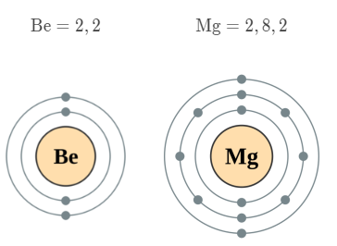
Just like for group 1, the elements in group 2 get more reactive as you move down the group.
The atoms get larger as you move down the group, meaning the valence electrons are further away from the nucleus. The further away from the nucleus they are, the weaker the attractive force between the negatively charged electrons and the positively charged nucleus, making it easier to remove the valence electrons.
The electron arrangements of the first three group 2 elements are shown below.

Slide 17
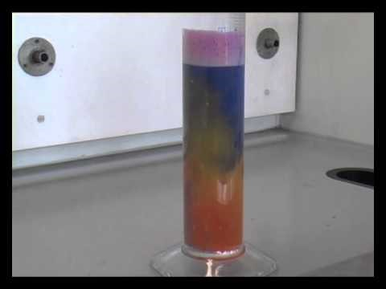

Slide 18
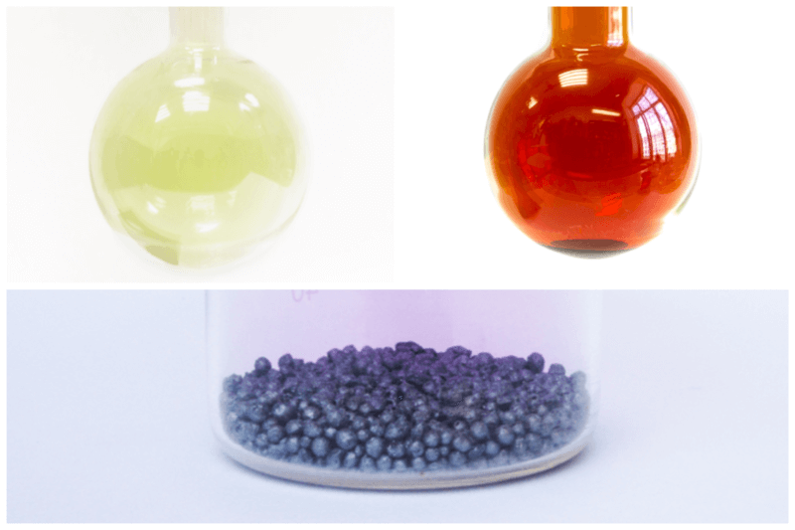
Elements in group 17 of the periodic table are known as the halogens.
These elements are all non-metals. Fluorine and chlorine are both slightly yellow gases at room temperature, bromine is an orange liquid, and iodine is a purple-black solid.

Slide 19
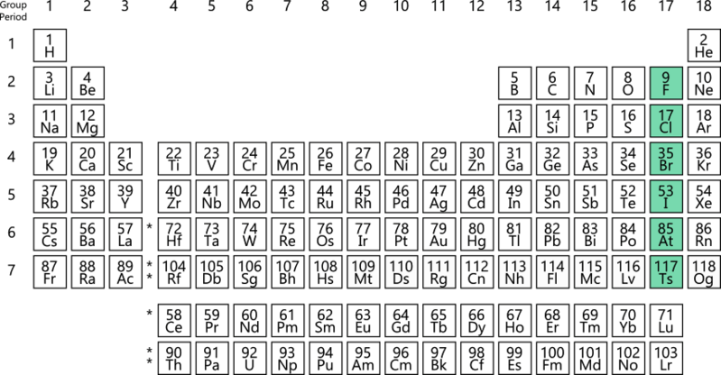
The halogens are all very reactive. This is because they only need to gain one electron to fill their valence shell and become stable, which does not require much energy.
Their reactivity means they are also very toxic, due to their ability to react with most of the chemical compounds in your body.

Slide 20
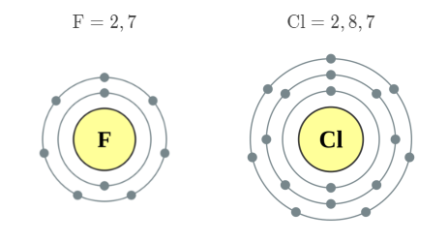
The elements in group 17 get less reactive as you move down the group.
The atoms get larger as you move down the group, meaning the valence shell is further away from the nucleus. This means the attractive force between the negatively charged electrons and the positively charged nucleus is weaker, making it more difficult to attract an electron into the valence shell.
The electron arrangements of some group 17 elements are shown below:

Slide 21
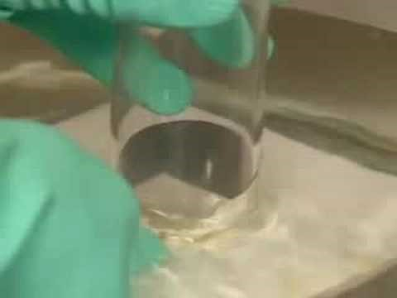

Slide 22
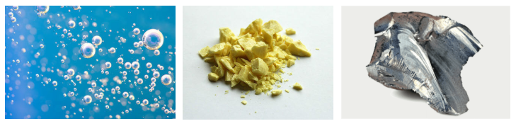
Elements in group 16 of the periodic table are sometimes known as the chalcogens, although this name is not very common.
Like the halogens, most of these elements are non-metals. Oxygen is a colourless gas at room temperature, sulfur is a yellow solid, and selenium is a red or grey solid.

Slide 23
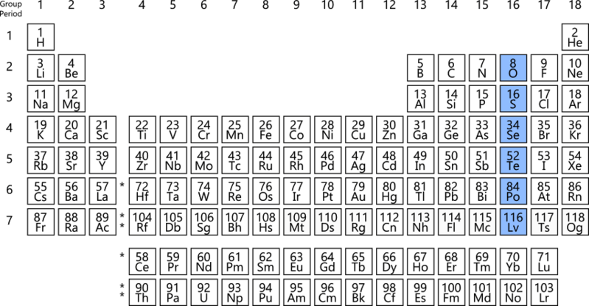
In order to gain a full valence shell and become stable, group 16 elements need to gain two electrons.
They are less reactive than the group 17 elements, because it is harder (requires more energy) to gain two electrons than to gain one electron to fill the valence shell.

Slide 24
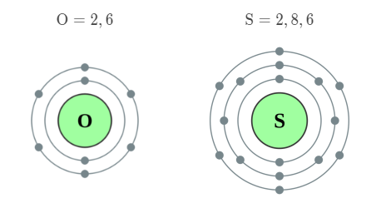
Group 16 elements get less reactive as you move down the group.
This is because the atoms get larger as you move down the group, meaning the valence shell is further away from the nucleus. This means the attractive force between the negatively charged electrons and the positively charged nucleus is weaker, making it more difficult to attract two electrons into the valence shell.
The electron arrangements of some group 16 elements are shown below:

